Slide 1
Interactive Scoreboard
By Richard Richardson

Slide 2
Agenda
Getting Started the Anaconda Environment
Systems Engineering Overview
Review Object Oriented Programming Principles
Overview of Program
Build the data types
Import the data
Output the data

Slide 3
System Engineering Overview
Most systems are data centric
Data In
Manipulate Data
Data Out
System
Data In
Data Out

Slide 4
System Engineering Overview
Steps to building a system
Define the data the system will operate on
Define where the data will come from
Define what the system will do with the data
Define where the data goes
Data Storage
System
Display
Data Storage

Slide 5
Object Oriented Programming
Object-oriented programming is a programming paradigm, or classification, that organizes a group of data attributes with functions or methods into a unit, known as an object
Typically, OOP languages are class-based, meaning a class defines the data attributes and functions as a blueprint for creating objects
Class: A class is a data type that provides a framework for creating objects
Use to define common characteristics among many elements
A Human has a name, birthdate, social security number, birthplace, etc
Object: In OOP, an object represents an instance, or creation, of a class
Inherits the common characteristics defined by the class
Richard is a human and therefore has all of the common characteristics
Defines Richards specific characteristics

Slide 6
SE101 – Object Oriented Programming
Object-oriented programming is a programming paradigm, or classification, that organizes a group of data attributes with functions or methods into a unit, known as an object
Typically, OOP languages are class-based, meaning a class defines the data attributes and functions as a blueprint for creating objects
Method: A method is a function that performs a task or action
Update Richards Age, etc
Attribute: This structure stores information about an object and defines its state
Richard is 51
Richards birthplace is Dayton, Ohio

Slide 7
Program Requirements/Overview
Define Purpose of Program and requirements

Slide 8
Program Requirements
Develop a program to display scores from games from different sports
Allow user to select which sport scores to display
The display must update in real-time
The scores will be read from a data file. As the files are updated the display reflects the changes

Slide 9
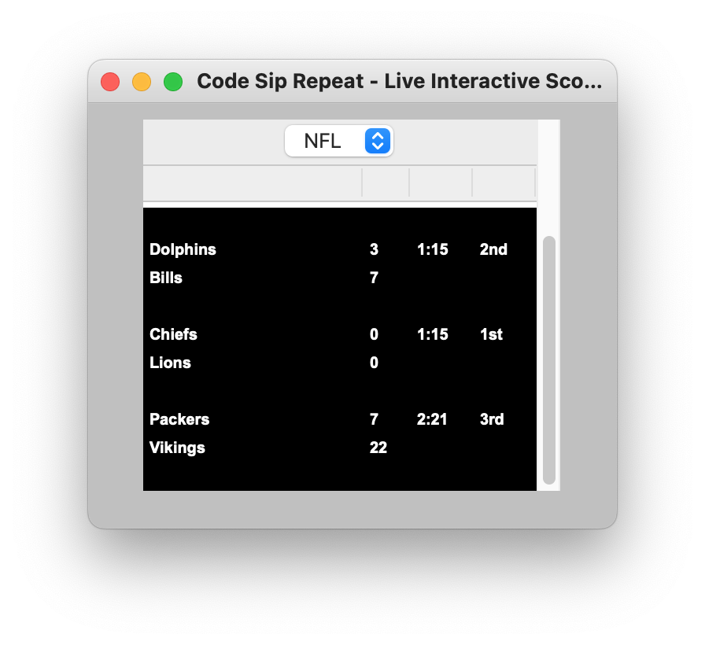
Program Requirements
The final display will look like the image below

Slide 10
Prerequisites
Ensure Anaconda is installed
Create new Environment within Anaconda
Install CMD.exe prompt from within Anaconda
Install Jupyter Notebook within Anaconda
Use CMD.exe to install Tkinter package
Create 3 .csv files
1 - nba_scores.csv
2 - nfl_scores.csv
3 - ncaaf_scores.csv

Slide 11
Build the Data
Define the Data Types that will be used

Slide 12
Build the Data Types
Begin by creating a file dataTypes.py
The code snippets that will be shown in the following slides in this section should be added to the dataTypes.py file

Slide 13
Build the Data Types
The structure of the data will follow the hierarchy as shown below
Scoreboard
Game 1
Game 2
Game 3
Team 1
Team 2
Team 1
Team 2

Slide 14
Data Type - Team
#This datatype defines all of the data associated with a team
class team:
def __init__(self, name, score):
self.name = name
self.score = score
Note:
The __init__ function is called every time an object is created from a class. The __init__ method lets the class initialize the object's attributes and serves no other purpose. It is only used within classes

Slide 15
Data Type - Game
#This datatype defines all the data required for a game
class game:
def __init__(self, name1, name2):
self.team1 = team(name1, 0)
self.team2 = team(name2, 0)
self.period = ""
self.time = ""
Note:
Each game can only have 2 teams

Slide 16
Data Type - Game
Let’s add some methods/functions to the game data type
#Method to update the score
def updateScore(self, score1, score2):
self.team1.score = score1
self.team2.score = score2
#Method to udate the time left in the game
def updateTime(self, period, time):
self.period = period
self.time = time
#Define a method to determine if 2 instances of this class object are equal
def __eq__(self, other):
if not isinstance(other, game):
return NotImplemented
#Returns true if the name of both teams are the same and false otherwise
return self.team1.name == other.team1.name and self.team2.name == other.team2.name
Note:
These methods are simple for the sake of time, but we could easily add some error checking to validate the input parameters.

Slide 17
Data Type - Scoreboard
class scoreboard:
def __init__(self):
self.games = []
Let’s add some methods to the scoreboard data type
#Add a new game to the scoreboard object
def addGame(self, match):
self.games.append(match)
#remove a game from the scoreboard
def removeGame(self, match):
self.games.remove(match)
#get the info for a particular game
def getGame(self, i):
return self.games[i]
#Delete all of the games in the list
def deleteGames(self):
self.games.clear()
#Update a game that is already in the list
def updateGame(self, match):
z = 0
for i in self.games:
if match == i:
self.games[z] = match
z += 1
#Check to see if the game is already in the list
def findGame(self, match):
for i in self.games:
if match == i:
return True
return False

Slide 18
Retrieve the Data
Build the method of populating the data objects

Slide 19
Retrieve the Data
Begin by creating a file importData.py
The code snippets that will be shown in the following slides in this section should be added to the importData.py file
The following code will be used to read a csv file and populate the data structures

Slide 20
Import Data Method
def populateScoreboard(tempScoreboard, sport):
match sport:
case "NBA":
dataFile = "nba_scores.csv"
case "NFL":
dataFile = "nfl_scores.csv"
case "NCAAF":
dataFile = "ncaaf_scores.csv"
case _:
dataFile = "Not Selected"
if dataFile != "Not Selected":
tempScoreboard.deleteGames()
with open(dataFile) as csv_file:
#Return to top of csv file
csv_file.seek(0)
csv_reader = csv.reader(csv_file, delimiter=',')
for row in csv_reader:
newGame = dataTypes.game(row[1], row[3])
newGame.updateScore(row[2], row[4])
newGame.updateTime(row[5], row[6])
if row[0] == "Y":
#Make sure it is not already in the list before adding
if tempScoreboard.findGame(newGame) is False:
tempScoreboard.addGame(newGame)
else:
tempScoreboard.updateGame(newGame)

Slide 21
Output the Data
Build the scoreboard display where the data will be displayed

Slide 22
Building the Display
Begin by creating a file manageDisplay.py
The code snippets that will be shown in the following slides in this section should be added to the manageDisplay.py file
The following code will be used to build the display and update the display in real time

Slide 23
Building the Display
def __init__(self):
#Create an instance of the scoreboard object and list of display objects
self.scoreboard = dataTypes.scoreboard()
def createMainWindow(self):
#Configure the root window of the scoreboard. When using tk package every display has to be contained within a main window
self.mainWindow = tk.Tk()
#Set the title of the main window
self.mainWindow.title("Code Sip Repeat - Live Interactive Scoreboard")
self.mainWindow.geometry('780x340')
self.mainWindow.configure(bg="silver")
#Create a frame container to hold the display. This container resides within the main window
def createFrame(self):
self.frame = ttk.Frame(self.mainWindow)
self.frame.pack(padx=10, pady=10)

Slide 24
Building the Display
#Add scrollbar to right side of the frame
def addScrollbar(self):
#Create a scrollbar for the display
self.scrollbar = ttk.Scrollbar(self.frame)
self.scrollbar.pack(side=RIGHT, fill=BOTH)
#Add a drop down menu to select which sports scores to display
def addDropDownMenu(self):
self.variable = StringVar(self.frame)
self.menu = ttk.OptionMenu(self.frame, self.variable, "Sports", "NFL", "NBA", "NCAAF", "NCAAB", "NHL")
self.menu.pack()

Slide 25
Building the Display
def createDisplay(self):
self.display = ttk.Treeview(self.frame,
yscrollcommand=self.scrollbar.set,
selectmode='none',
show=["headings"],
columns=("1", "2", "3", "4"),
displaycolumns=("1", "2", "3", "4"))
self.scrollbar.config(command=self.display.yview)
#Set column widths
self.display.column("1", width=140, stretch=NO)
self.display.column("2", width=30, stretch=NO)
self.display.column("3", width=40, stretch=NO)
self.display.column("4", width=40, stretch=NO)
self.display.heading("1", text="Game")
self.display.heading("2", text="Score")
self.display.heading("3", text="Time")
self.display.heading("4", text="Period")
self.display.pack(expand=True)
style = ttk.Style()
style.configure("Treeview",
background="black",
foreground="white",
font=('Arial Bold', 10))

Slide 26
Building the Display
#Get scores and refresh window every 10 seconds
def update(self):
#Get the current game data
importData.populateScoreboard(self.scoreboard, self.variable.get())
for i in self.display.get_children():
self.display.delete(i)
y = 0
for i in self.scoreboard.games:
self.display.insert('', y,values=(i.team1.name, i.team1.score, i.time, i.period))
self.display.insert('', y+1,values=(i.team2.name, i.team2.score))
self.display.insert('', y+2,values=("", ""))
#Move display pointer to next game location
y += 3
#Update display every 5 seconds
self.display.after(5000, self.update)

Slide 27
Building the Display
#Start the main display and continue to update display based on timer
def start(self):
#Create the main window and the display area where the scores are displayed
self.createMainWindow()
self.createFrame()
self.addScrollbar()
self.addDropDownMenu()
self.createDisplay()
#Add the initial list of games
self.update()

Slide 28
Create the Main Program

Slide 29
Create the Main Program
Create ipykernel in Jupyter Notebook
Insert the following code snippet
import manageDisplay
#Create an instance of ManageScoreboard Object
window = manageDisplay.ManageScoreboard()
window.start()
window.mainWindow.mainloop()

